Slide 1



SEARED AHI TUNA* seared rare blackened ahi tuna, black bean succotash, cilantro lime sauce, coconut basmati rice, fried plantain chip | 620 cal | 15.50
STEELHEAD B.L.T. grilled steelhead, bacon, lemon dill aioli, butter bibb, tomato on sourdough bread served with your choice of side | 600 cal | 14.95
BEEF + MAITAKE BURGER beef patty, seared maitake mushrooms, provolone cheese, umami sauce, arugula, red onions on a brioche bun served with your choice of side | 780 cal | 13.30
BRIE + CHICKEN SANDWICH grilled chicken breast, brie cheese, cherry relish, dijonaise, arugula lettuce, red onion on a brioche bun served with your choice of side | 670 cal | 11.75
COBB SALAD V romaine + bibb lettuce, arcadian greens, chopped egg, corn, cucumber, red onions, grape tomatoes, rosemary dill croutons with choice of dressing add chicken +4.45 | add steelhead +4.45 | 450 cal | 9.20
BEECHER’S MAC + CHEESE cavatappi noodles with creamy beecher’s cheese sauce, chili herb crunch gremolata, tomato confit add chicken +4.50 | add arugula & caramelized onions +1.50 | 820 cal | 9.20
STEELHEAD & SALMON CHOWDER BREAD BOWL smoked salmon, steelhead, potatoes, corn, caramelized sweet onion, citrus, pink peppercorn and fried leeks served in bread bowl served with a fennel salad | 750 cal | 13.30
SEASONED WAFFLE FRIES VN | 350 cal | 2.55
SIDE SALAD VN blended greens, grape tomatoes, red onions, radish, croutons with your choice of dressing | 120 cal | 2.55
VN Vegan V Vegetarian
2000 calories a day is used for general nutrition advice, but calorie needs vary. Additional nutrition information available upon request. *Consuming raw or undercooked meats, poultry, seafood, shellfish or eggs may increase your risk of foodborne illness, especially if you have medical conditions.

Slide 2
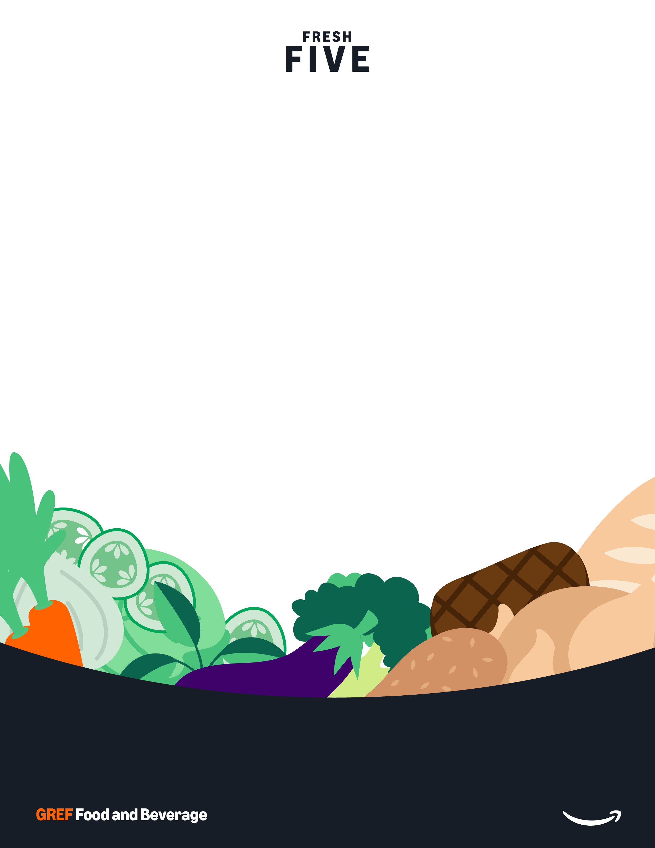

2 offerings
FRESH 5: BLACK BEAN BURGER black bean burger topped with lettuce blend, onion and tomato on brioche bun 410 cal 5.00 FRESH 5: BLACKENED CHICKEN CAESAR WRAP blackened chicken with fresh lettuce blend, parmesan cheese and creamy caesar dressing in tortilla wrap 600 cal 5.00

Slide 3






BURRITO fresh pressed tortilla with cilantro lime rice, shredded romaine and your choice of proteins, beans and toppers 515 CAL / 11.55
QUESADILLA fresh pressed tortilla with our cheese blend and your choice of protein and toppers 675 CAL / 10.20
TACOS (3) three tacos with shredded romaine and your choice of protein and toppers 210 CAL / 10.20
BURRITO BOWL chopped romaine, cilantro lime rice, and your choice of protein, beans and toppings, with a tortilla on the side 515 CAL / 11.55
AL PASTOR PORK +250 CAL GRILLED CHICKEN +150 CAL
SOYRIZO VN +115 CAL
EXTRA PROTEIN +4.50
CHIPS + SALSA VN VARIES CAL / 3.30 CHIPS + GUAC VN 745 CAL / 5.70
CHIPS + QUESO V 915 CAL / 5.70
QUESO V 220 CAL / 2.55
GUACAMOLE VN 250 CAL / 2.55
BLACK BEANS VN | 150 CAL / 2.55 | SIDE QUESO V | 220 CAL / 2.55
PINTO BEANS VN | 145 CAL / 2.55 | CILANTRO LIME RICE VN | 190 CAL / 2.55
roasted corn salsa VN 35 CAL salsa roja VN 80 CAL
salsa verde VN 10 CAL
habanero salsa VN 15 CAL
pico de gallo VN 25 CAL
sour cream V 110 CAL shredded romaine VN 10 CAL diced tomatoes VN 10 CAL diced jalapeños VN 10 CAL
V vegetarian VN vegan
2000 calories is used as general nutrition advice, but calorie needs may vary. Additional nutrition information available upon request.

Slide 4

THIS WEEK’S MENU
Monday – Tuesday
Teriyaki
435 – 835 cal
grilled teriyaki protein with steamed rice, teriyaki salad, steamed broccoli, cucumber salad and teriyaki sauce
Grilled Tofu Portabella Teriyaki VN 11.75
medley of grilled portabella mushrooms and tofu with house made teriyaki sauce
Chicken Teriyaki 11.75
marinated and grille chicken in house made teriyaki sauce
Sides | 2.55
Steamed Rice 240 cal
Cucumber Salad 110 cal
Steamed Broccoli 50 cal
Teriyaki Salad 15 cal
2000 calories is used as general nutrition advice, but calorie needs may vary. Additional nutrition information available upon request. *Consuming raw or undercooked meats, poultry, seafood, shellfish or eggs may increase your risk of foodborne illness, especially if you have medical conditions.
vegan VN vegetarian V

Slide 5
THIS WEEK’S MENU
Wednesday - Friday
Teriyaki
435 – 835 cal
grilled teriyaki protein with steamed rice, teriyaki salad, steamed broccoli, cucumber salad and teriyaki sauce
Grilled Tofu Portabella Teriyaki VN 11.75
medley of grilled portabella mushrooms and tofu with house made teriyaki sauce
Chicken Teriyaki 11.75
marinated and grille chicken in house made teriyaki sauce
Sides | 2.55
Steamed Rice 240 cal
Cucumber Salad 110 cal
Steamed Broccoli 50 cal
Teriyaki Salad 15 cal
2000 calories is used as general nutrition advice, but calorie needs may vary. Additional nutrition information available upon request. *Consuming raw or undercooked meats, poultry, seafood, shellfish or eggs may increase your risk of foodborne illness, especially if you have medical conditions.
vegan VN vegetarian V

Slide 6
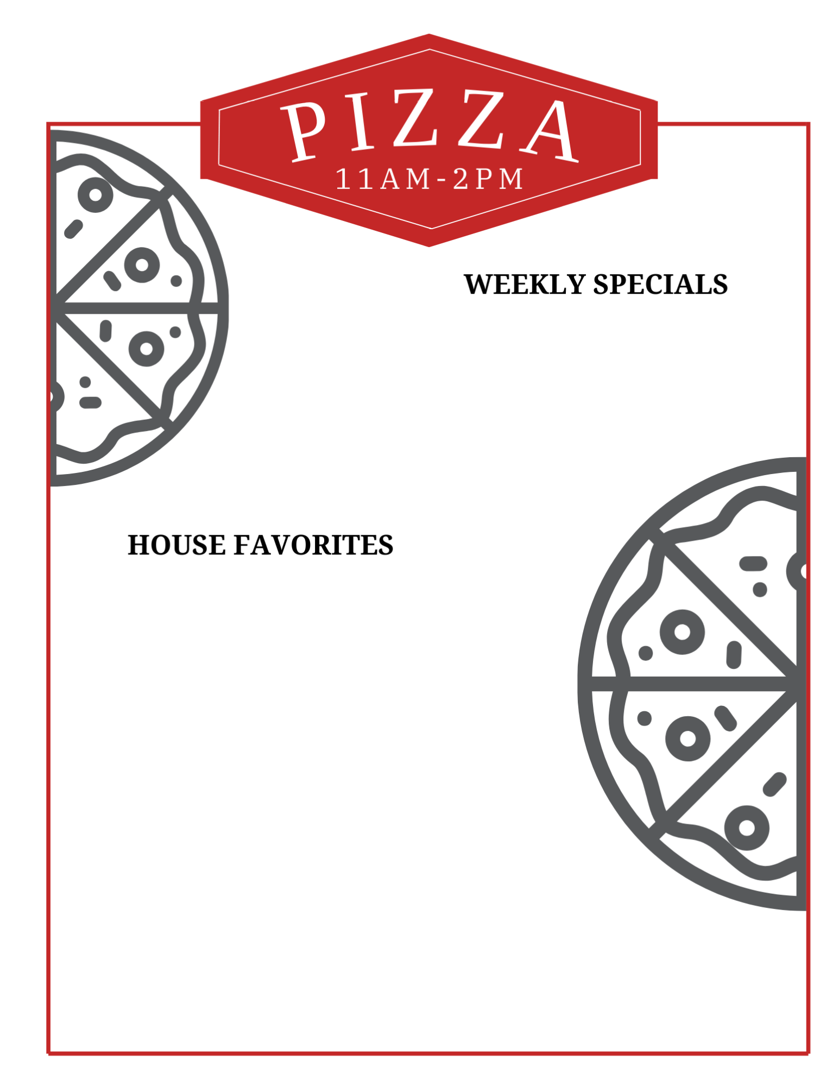

Daily Features
GARDEN PESTO FLATRBREAD V mushrooms, caramelized onions, asparagus, goat cheese, and pesto | 530 cal | 5.00
CAPRESE FLATBREAD V toasted flatbread topped with slow roasted tomatoes, mozzarella, basil and balsamic glaze | 610 cal | 5.00
SIGNATURE PIZZAS
QUATTRO FORMAGGI V house-made pizza sauce, fontina, parmesan, mozzarella + provolone cheeses | 900 cal | 9.20
MARGHERITA V house-made pizza sauce, mozzarella cheese, roma tomatoes + basil | 910 cal | 9.20
FORAGER’S PIE V house-made pizza sauce, seasonal mushrooms + vegetables, caramelized onions + arugula | 740 cal | 11.55
PEPPERONI + SALAMI house-made pizza sauce, fontina, parmesan, mozzarella + provolone cheeses | 920 cal | 11.55
SAUSAGE + SWEET PEPPER house-made pizza sauce, fontina, parmesan, mozzarella + provolone cheeses, fennel sausage + fried herbs | 890 cal | 11.55
cast iron baked chocolate chip cookie topped with vanilla ice cream
740 cal
V vegetarian VN vegan
2000 calories is used as general nutrition advice, but calorie needs may vary. Additional nutrition information available upon request. *Consuming raw or undercooked meats, poultry, seafood, shellfish or eggs may increase your risk of foodborne illness, especially if you have medical conditions.

Slide 7
3 offerings
FRESH 5: NEW MEXICAN CHIPOTLE FLATBREAD V Chipotle sausage, caramelized onions, sweet peppers, oaxaca cheese, and cilantro pesto 595 CAL 5.00
GARDEN PESTO FLATRBREAD V mushrooms, caramelized onions, asparagus, goat cheese, and pesto | 530 cal | 5.00
CAPRESE FLATBREAD V toasted flatbread topped with slow roasted tomatoes, mozzarella, basil and balsamic glaze | 610 cal | 5.00

Slide 8





BUILD YOUR OWN SALAD VN choose your salad greens, eight toppings, dressing and protein 50-750 cal / 9.20 + 4.50 protein
SMOKED ALMOND COBB SALAD V romaine, arugula, spinach, avocado, cucumber, pickled red onions, grape tomatoes, shredded carrots, blue cheese, egg, smoked almonds 200 cal / 9.20 + 4.50 protein
CAESAR SALAD V romaine, kale, parmesan cheese, xx, lemon, caesar dressing 540 cal / 9.20 + 4.50 protein
FRESH ROLL / 1.00
12 OZ / 5.15 16 OZ / 6.10
MONDAY
Garden Vegetable VN | 225 / 320
Loaded Baked Potato | 420 / 560
TUESDAY
Italian Tomato Bisque V | 150 / 200
Southwest Chicken Tortilla | 335 / 450
WEDNESDAY
Baja Chicken | 345 / 495
Curried Lentil and Rice V | 235 / 315
THURSDAY
Vegetarian Minestrone V | 185 / 245
Vegetable Beef Barley | 135 / 180
FRIDAY
Corn Chowder V | 315 / 415
Chicken Noodle | 300 / 400
Dressing V | 115 cal
Dressing V | 180 cal
Vinaigrette V | 25 cal
Vinaigrette VN | 110 cal
Vinegar VN | 5 cal
Dressing VN | 240 cal
FRESH 5 : CHICKEN + BUTTERNUT SQUASH BULGUR SALAD grilled chicken, bulgur wheat, sundried tomatoes, roasted butternut squash, green onions, feta cheese + spring mix with citrus vinaigrette
390 cal / 5.00
FRESH 5: MAPLE TOFU BARLEY PECAN SALAD
yams, barley, pecans, celery, red onion, cranberry, tofu, broccoli, arugula
275 cal / 5.00
VEGAN VN | VEGETARIAN V
2000 calories is used as general nutrition advice, but calorie needs may vary. Additional nutrition information available upon request. *Consuming raw or undercooked meats, poultry, seafood, shellfish or eggs may increase your risk of foodborne illness, especially if you have medical conditions.

Slide 9
BUILD YOUR OWN SALAD VN choose your salad greens, eight toppings, dressing and protein 50-750 cal / 9.20 + 4.50 protein
SMOKED ALMOND COBB SALAD V romaine, arugula, spinach, avocado, cucumber, pickled red onions, grape tomatoes, shredded carrots, blue cheese, egg, smoked almonds 200 cal / 9.20 + 4.50 protein
CAESAR SALAD V romaine, kale, parmesan cheese, xx, lemon, caesar dressing 540 cal / 9.20 + 4.50 protein
FRESH ROLL / 1.00
12 OZ / 5.15 16 OZ / 6.10
MONDAY
Garden Vegetable VN | 225 / 320
Loaded Baked Potato | 420 / 560
TUESDAY
Italian Tomato Bisque V | 150 / 200
Southwest Chicken Tortilla | 335 / 450
WEDNESDAY
Curried Lentil + Rice VN | 235 / 315
Red Curry Chicken + Lentil | 275 / 415
THURSDAY
Butternut Squash Bisque V | 280 / 320
Vegetable Beef Barley | 135 / 180
FRIDAY
Corn Chowder V | 315 / 415
Chicken Noodle | 300 / 400
Dressing V | 115 cal
Dressing V | 180 cal
Vinaigrette V | 25 cal
Vinaigrette VN | 110 cal
Vinegar VN | 5 cal
Dressing VN | 240 cal
FRESH 5: CURRY CHICKEN SALAD
chopped kale tossed with curried chicken, grapes, apples, celery, raisins, red onion, and cilantro
470 cal / 5.00
FRESH 5 : CHICKEN + BUTTERNUT SQUASH BULGUR SALAD grilled chicken, bulgur wheat, sundried tomatoes, roasted butternut squash, green onions, feta cheese + spring mix with citrus vinaigrette
390 cal / 5.00
FRESH 5: GRILLED CHICKEN + LENTIL SALAD
grilled chicken served with lentils and spring mix tossed in olive oil, red wine vinegar, mint, garlic, and topped with tomatoes, scallion, and bell peppers
730 cal/ 5.00
VEGAN VN | VEGETARIAN V
2000 calories is used as general nutrition advice, but calorie needs may vary. Additional nutrition information available upon request. *Consuming raw or undercooked meats, poultry, seafood, shellfish or eggs may increase your risk of foodborne illness, especially if you have medical conditions.

Slide 10

DELI
11:00AM – 2:00PM
8.90 - 9.90 BUILD YOUR OWN SANDWICH INCLUDES KETTLE CHIPS OR WHOLE FRUIT
BREADS CHOOSE 1
PROTEINS CHOOSE 1
RUSTIC POTATO ROLL V | 315 cal
SOURDOUGH V | 150 cal
WHOLE WHEAT VN | 150 cal
SPINACH HERB WRAP V | 180 cal
EGGLESS EGG SALAD VN | 210 cal
SALAMI | 130 cal
HONEY HAM | 225 cal
ROAST BEEF | 160 cal
TURKEY BREAST | 120 cal
SPREADS CHOOSE UP TO 2
CHEESES CHOOSE 1
CHIPOTLE AIOLI VN | 175 cal
DIJON MUSTARD VN | 30 cal
HORSERADISH AIOLI VN | 145 cal
VEGAN MAYO VN | 180 cal
PESTO V | 45 cal
ROASTED GARLIC AIOLI V | 140 cal
CHEDDAR V | 115 cal
PEPPER JACK V | 105 cal
BLUE CHEESE V | 110 cal
PROVOLONE V | 105 cal
SWISS V | 100 cal
white bean hummus with fresh arugula, tomato, cucumber, spinach, artichoke, and roasted red peppers on multigrain bread served with roasted vegetable chopped salad
FRESH 5: TUSCAN VEGETABLE SANDWICH (half)
TOPPINGS CHOOSE UP TO 5
BELL PEPPERS VN | 35 cal
BANANA PEPPERS VN | 10 cal
CARAMELIZED ONIONS VN | 60 cal
LEAF LETTUCE VN | 15 cal
OLIVES VN | 15 cal
PICKLED JALAPENO VN | 10 cal
SLICED CUCUMBERS VN | 10 cal
SLICED TOMATOES VN | 15 cal
SLICED RED ONIONS VN | 5 cal
EXTRAS
AVOCADO SPREAD VN 130 cal / 2.05 | CHEESE V 85 – 115 cal / 0.75 | BACON 160 cal / 2.05 | PROTEIN 120 – 225 cal / 4.55
FRESH 5 GREEK SALAD FLATBREAD SANDWICH
pepperoncini, romaine, feta, thyme vinaigrette, olives, cucumbers, tomato, flatbread
175 cal / 5.00
2000 calories a day is used for general nutrition advice, but calorie needs vary.
Additional nutrition information available upon request.
VN vegan V vegetarian

